Slide 1



March 30, 2019

Slide 2
Team 2
Rafael Moreno Contreras, Data Analytics
Robert Varadan, Computer Science
Bingo Lahaye, Marketing
Firenegar Getahun, Data Analytics
Tamrat Workineh, Data Analytics

Slide 3
Introduction - how did you approach the challenge?
We analyzed 14 elections over 7 years
We looked at weather trends, crime data, and voter turnout
We wanted to see how different conditions affected how many people showed up to vote

Slide 4
Method - additional data and description of analysis
Much time was spent pre-processing and “cleaning” the data
Some data had to be thrown out because it was uninterpretable
The data-sets mainly didn’t distinguish between registered voters and cast votes
There were many formatting differences between the different data sets
Different standards and naming schemes were used

Slide 5
Method (continued)
We combined the usable data-sets and merged duplicated features
We selected external data for weather and crime statistics
We grouped, filtered and merged all of the data
https://w2.weather.gov/climate/xmacis.php?wfo=lwx

Slide 6
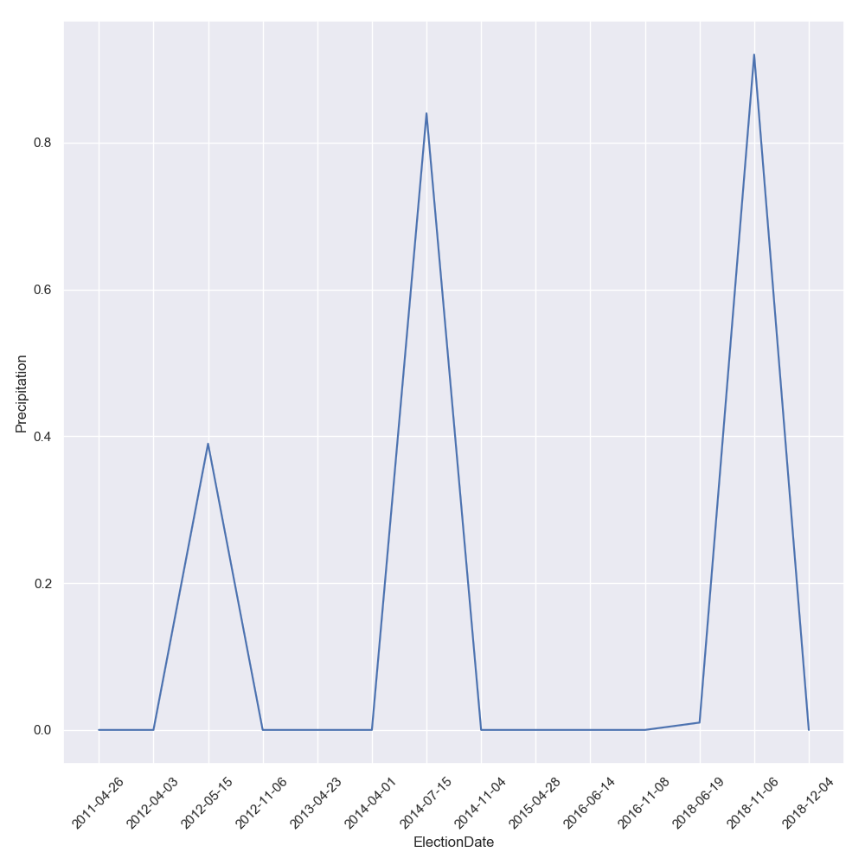
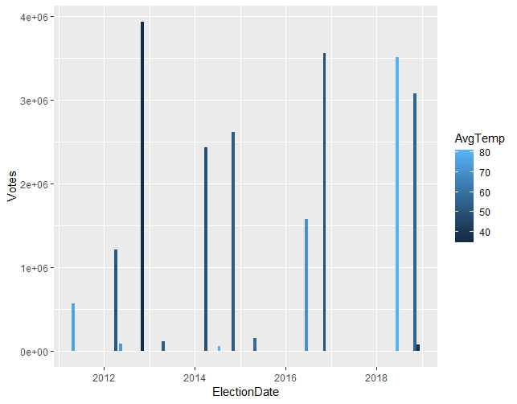
Results - insight(s) gained
Weather has little correlation to voter turnout

Slide 7
Results (continued)
We used crime data from 2013 to 2018
From yearly crime analysis, considering criminal activity as a whole, we did not see a significant correlation

Slide 8
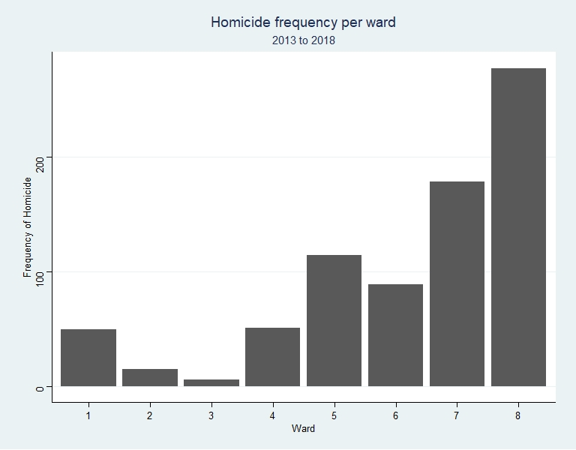
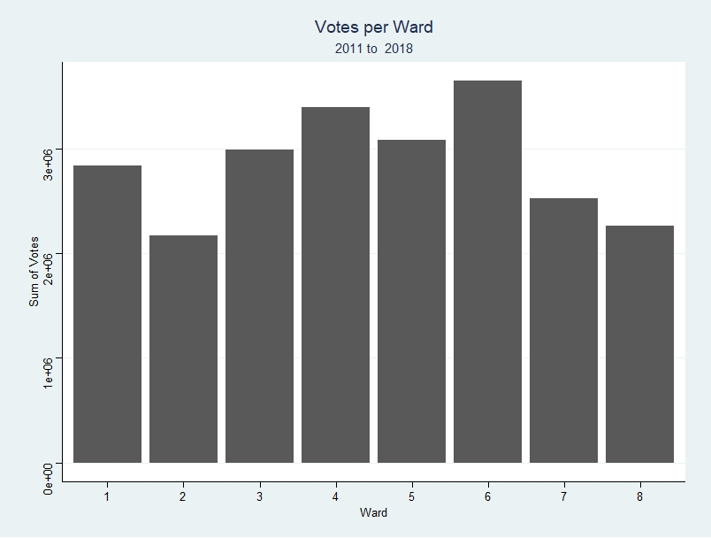
However, violent crime has some correlation to a lack in voter turnout.

Slide 9
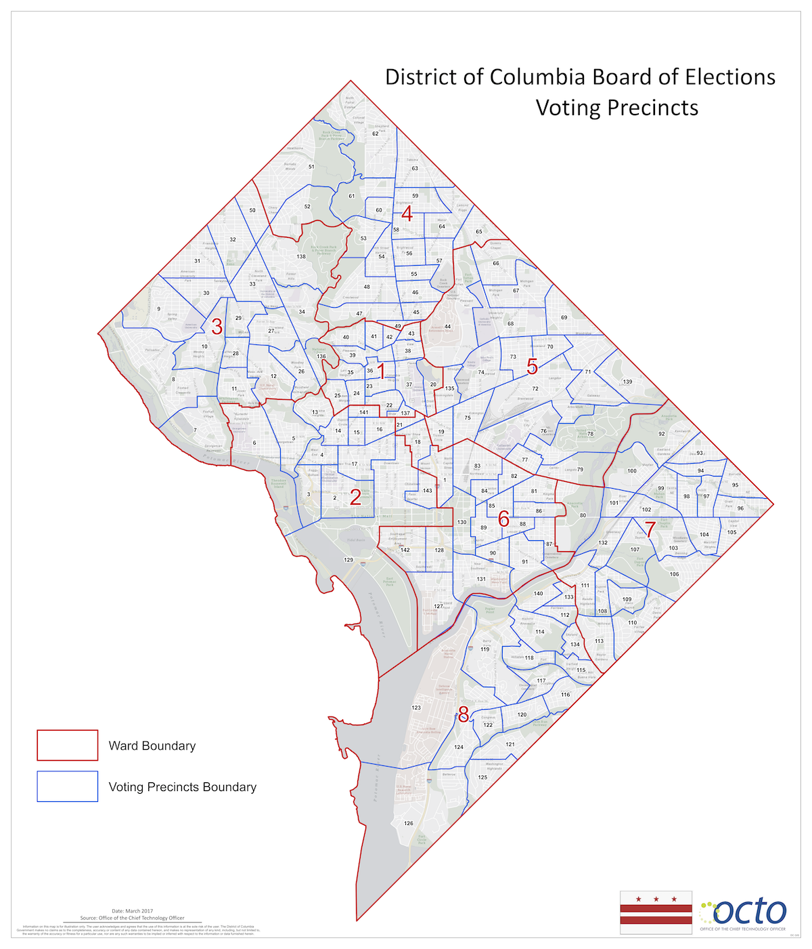
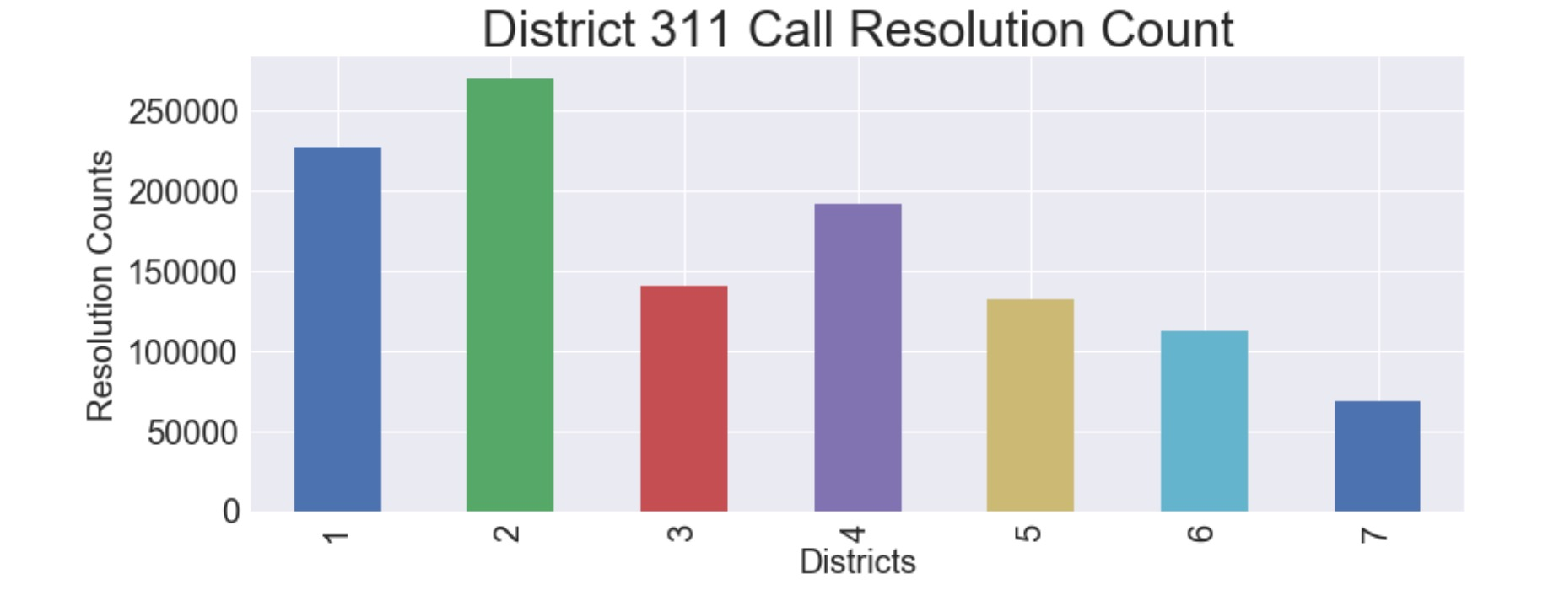

Slide 10
Discussion
Why does the unresolved high rate-of-crime correlate to low voter turnout?
Lack of trust in the system?
Elected officials failing to deliver on promises?
Does voting really make a difference?

Slide 11
Ethical considerations
These insights shouldn’t be used for the wrong reasons
Our insights are not deep enough to cause real harm
However, proper consideration for the common good should be considered when politicians examine this type of data

Slide 12
Conclusions / next steps
The cleaning of the data was an interesting challenge
It also comprised of the majority of the given time
Weather does not seem to affect voter turnout
Given more time, deeper insights into the crime rate and other factors affecting voter turnout would be possible
Ex: transportation, traffic, etc.

